Slide 1


Student Reminder App
Name: Tiisetso Matabane
Student no: 202240101
Module: NHCI63110 – Human-Computer Interaction

Slide 2
Topics:
User Research, Personas, Scenarios
Conceptual Model & Interaction Thinking
Interface Sketches
Django Wireframe (structure & layout)
Evaluation Plan
Reflection

Slide 3

User Research
Students struggle to manage academic tasks while maintaining well-being.
Main Points:
- Missed deadlines
- Burnout from poor work-life balance
- Disconnected scheduling tools

Slide 4
Personas
🧑 Thabo – Final-year CS student
- Overwhelmed by project deadlines, forgets to take breaks
👩 Lerato – First-year ICT student
- Needs time management support, experiences anxiety

Slide 5
Scenarios
Scenario 1: Thabo receives a break reminder after 2 hours of focused study.
Scenario 2: Lerato views a color-coded calendar to plan her day with wellness breaks.

Slide 6

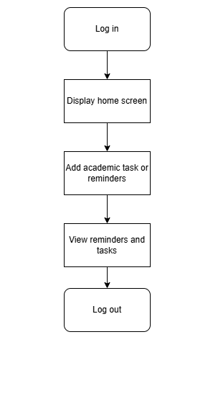
Conceptual Model

Slide 7
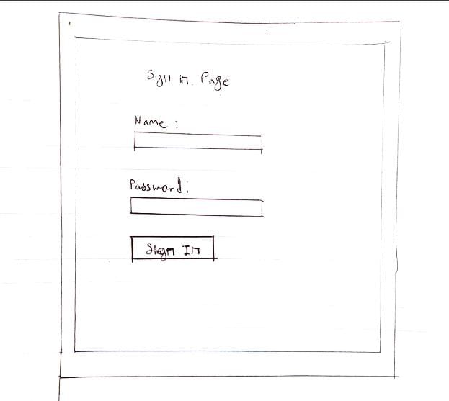
Interface Sketches

Slide 8
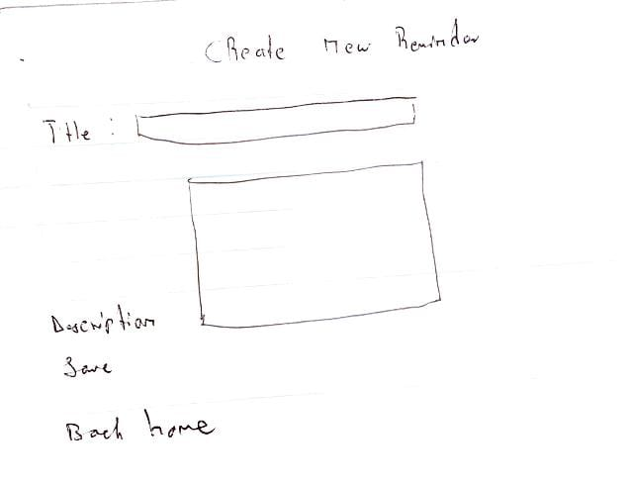
Interface sketches

Slide 9
Annotations
Annotations:
Visibility (Clear Priorities)
Calendar , Tasks , and icons are prominently placed at the top for quick access.
Task list is prioritized over other elements (larger font, centered).
Feedback (Interactive Elements)
Mood selector shows immediate visual feedback (e.g. highlights when selected)..
Constraints (Guided Actions)
"Submit" button for mood check-in is disabled until a mood is selected (grayed out).
GITHUb link
https://github.com/Tiisetso-githb/Tiisetso_HCI.git

Slide 10
Core Features
✔ Task & Reminder Management
✔ Calendar Integration
✔ Smart Notifications

Slide 11
Django wireframe
Interaction Types:
- Instructing (forms, buttons)
- Exploring (calendar), set reminders

Slide 12
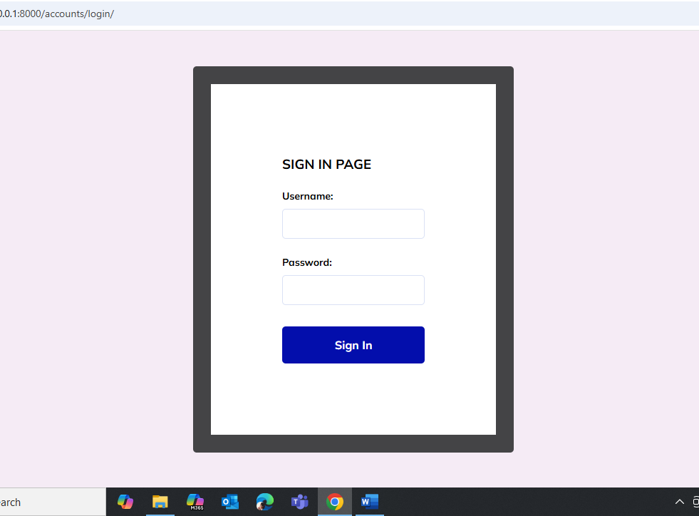

Slide 13
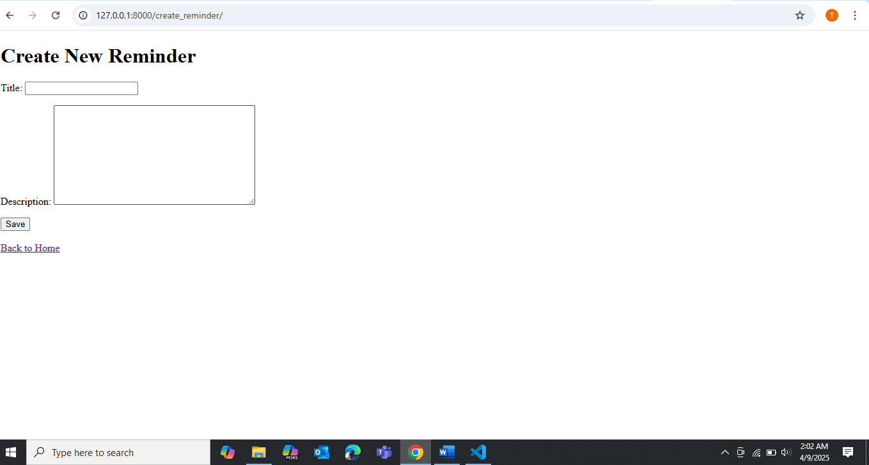
Screenshot

Slide 14
Evaluation Planning
Goals:
- Complete task in ≤30 seconds
- Improve user control by 20% in 1 week
Method: Think-Aloud with 5 students
Questions:
- Was the interface intuitive?
- Were reminders helpful or annoying?

Slide 15

Reflection
Learnings:
- Importance of listening to users
- Concept modeling clarified app structure
- Wireframes helped reveal real limitations
Next time: Do more low-fi sketches before coding

Slide 16

Thank you

